Slide 1
IIS Servers and LAMP Servers

Slide 2
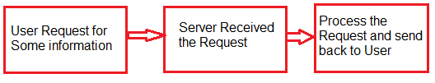
IIS Servers
The term "IIS" stands for Internet Information Services, which is a general-purpose webserver that runs on the Windows operating system.
The IIS accepts and responds to the client's computer requests and enables them to share and deliver information across the LAN (or Local Area Network) such as a corporate intranet and the WAN (or Wide Area Network) the internet.
An IIS web server runs on the Microsoft .NET platform on the Windows OS. While it’s possible to run IIS on Linux and Macs using Mono, it’s not recommended and will likely be unstable.

Slide 3
How IIS works
It works through several different standard languages and protocols.
HTML is used for creating a variety of elements. For example, texts, buttons, hyperlinks, etc.
The HTTP (or Hyper Text Transfer Protocol) is used for exchanging the information between the two or more servers and users.
HTTPS --HyperText Transfer Protocol Secure over the SSL (or Secure Sockets Layer) -- uses SSL (secure sockets layer ) to encrypt the communication to add additional data security.
The FTP (or File Transfer Protocol ), or its secure variant, FTPS, can transfer files.

Slide 4
Some of the ways that can be used to harden the IIS to avoid the security breaches are listed below:
Configuration of error pages should be done in such a way that they will display only relevant information about the issues received. The error pages do not display unnecessary information such as IP addresses of servers, user IDs and passwords or any other type of information that can help hackers in exploiting the webserver.
The "URL authorization" must be used in order to apply rules for specific requests e.g., dealing with a particular kind of URLs. URL authorization allows a company to authorize only certain users to view the requested pages.
Always use the firewall to ensure that only valid data package can reach the server.
Whenever Windows gets an update, the Windows operating system should be updated with the latest security patches.
The logging must be used to manage the record of the visitors that access the webserver.

Slide 5
Differences between IIS and Apache
IIS comes as a package with windows and apache is an open software.
While IIS runs only on the windows, Apache can run on different OS.(mac,Linux,etc)
The IIS has its own help desk to fix the issues, but in Apache's case, almost all of its support is provided by the user community.
The security features of the IIS are more reliable than the Apache web server, which makes it a better option than the Apache.

Slide 6
Internet Information Server (IIS) is one of the most popular web servers from Microsoft that is used to host and provide Internet-based services to ASP.NET and ASP Web applications. A web server is responsible for providing a response to requests that come from users. When a request comes from client to server IIS takes that request from users and process it and send response back to users.

Slide 7
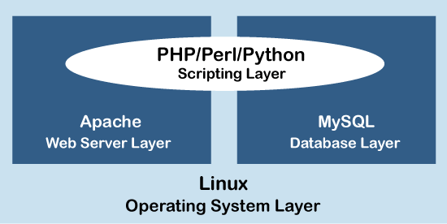
What is LAMP?
LAMP is an open-source Web development platform that uses
Linux as the operating system,
Apache as the Web server,
MySql as the relational database management system and
PHP/Perl/Python as the object-oriented scripting language.
Linux,Apache, MySQL and PHP, all of them add something unique to the development of high-performance web applications.

Slide 8
LAMP Stack Components
Linux: Linux started in 1991. It sets the foundation for the stack model. All other layers are run on top of this layer. It is an open-source and free operating system. It is endured partly because it's flexible, and other operating systems are harder to configure.
Apache: The second layer consists of web server software, typically Apache Web Server. This Apache HTTP Server is a free web server software package made available under an open-source license. It offers a secure and extendable Web server that's in sync with current HTTP standards.
MySQL: MySQL is a relational database management system used to store application data. It is an open-source and keeps all the data in a format that can easily be queried with the SQL language.
MySQL stores details that can be queried by scripting to construct a website. MySQL usually sits on top of the Linux layer alongside Apache.

Slide 9
PHP: The scripting layer consists of PHP and other similar web programming languages. The PHP open-source scripting language works with Apache to create dynamic web pages. We cannot use HTML to perform dynamic processes. To provide this type of functionality, we drop PHP code into the parts of a page that you want to be dynamic. Websites and Web Applications run within this layer.

Slide 10
Advantages of LAMP
The LAMP stack consists of four components, all of which are examples of Free and Open-Source Software (FOSS). As they are free and available for download, it attracts the attention of many users who wish to avoid paying large sums of money when developing their website.
Because it is FOSS, the source code of the software is shared and available for people to make changes and improvements, enhancing its overall performance.
The LAMP stack has proven to be a secure and stable.
We can easily customize the stack and interchange the components with other open-source software to suit the needs.

Slide 11
Thank you

